Slide 2
Computational approaches for the therapeutic target discovery to ame-liorate muscle wasting during aging and disease
Msc Karen Guerrero Vazquez
Dr. Katarzyna Whysall
Dr. Pilib O Broin

Slide 3
Update # 3

Slide 4
Content
Summary
Pathway analysis
MicroArray analysis
Network analysis
Notes:
We mentioned that aging have a lot of factors attached to it, in the specific case of Sarcopenia we can include chronic inflammation, increased reactive oxidative species, and increased fibrosis of muscle, among others have been reported to contribute to development of sarcopenia

Slide 5
Summary
Notes:
We mentioned that aging have a lot of factors attached to it, in the specific case of Sarcopenia we can include chronic inflammation, increased reactive oxidative species, and increased fibrosis of muscle, among others have been reported to contribute to development of sarcopenia

Slide 6
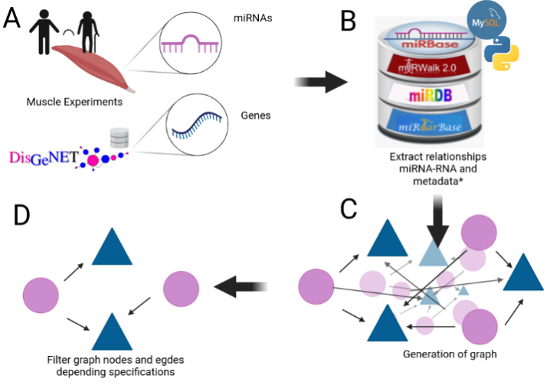
Notes:
We mentioned that aging have a lot of factors attached to it, in the specific case of Sarcopenia we can include chronic inflammation, increased reactive oxidative species, and increased fibrosis of muscle, among others have been reported to contribute to development of sarcopenia

Slide 7
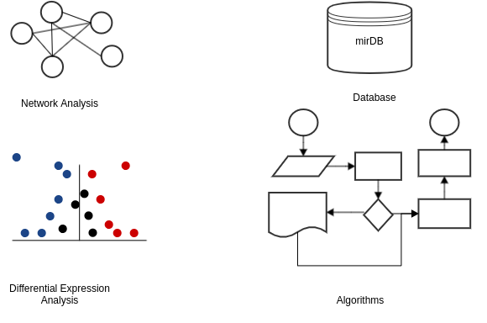
Key points

Slide 8
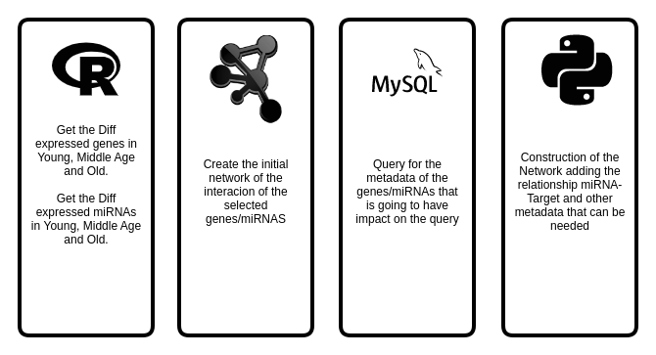
Key points

Slide 9
My Experiments
Target | Type | N. Experiments
mRNA | RNASeq | 3
 | MicroArray | 4
miRNA | MicroArray | 1
 | miRSeq | 2
Proteomics | - | 1

Slide 10
Experiment | Evaluation | Regulation | Genes
GSE152558 | MO | Down | 9
GSE152558 | MO | UP | 8
GSE157585 | YO | Down | 73
GSE157585 | YO | UP | 9
GSE164471 | OY | Down | 8
GSE164471 | OY | UP | 5
GSE164471 | MY | Down | 2
GSE164471 | MY | UP | 2
GSE164471 | MO | Down | 11
GSE164471 | MO | UP | 6
GSE875105 | OY | Down | 88
GSE875105 | OY | Up | 18
GSE875105 | MO | Up | 6
GSE23527 | YO | Down | 5
GSE23527 | YO | Up | 1
Notes:
We mentioned that aging have a lot of factors attached to it, in the specific case of Sarcopenia we can include chronic inflammation, increased reactive oxidative species, and increased fibrosis of muscle, among others have been reported to contribute to development of sarcopenia

Slide 11
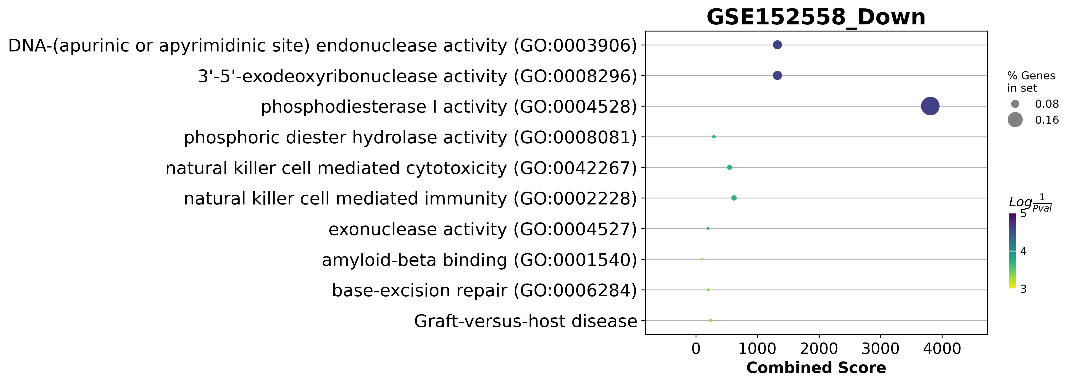
GSE152558 Dotplot

Slide 12
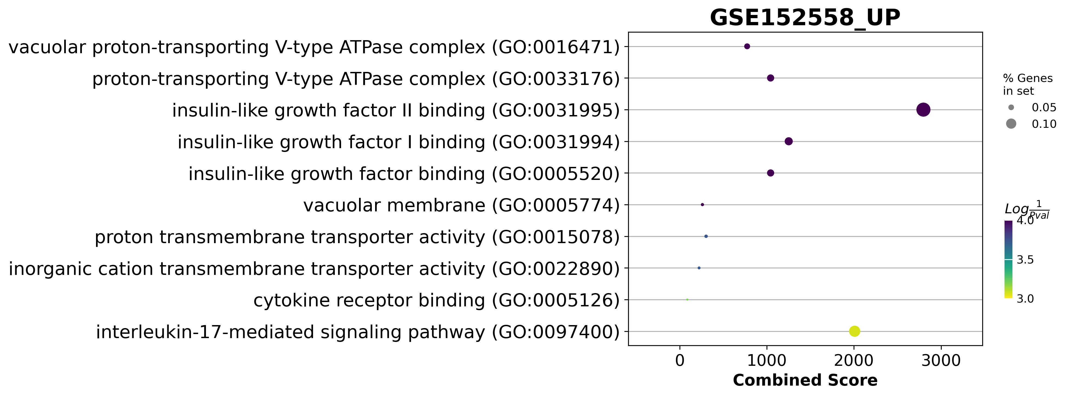
GSE152558 Dotplot

Slide 13
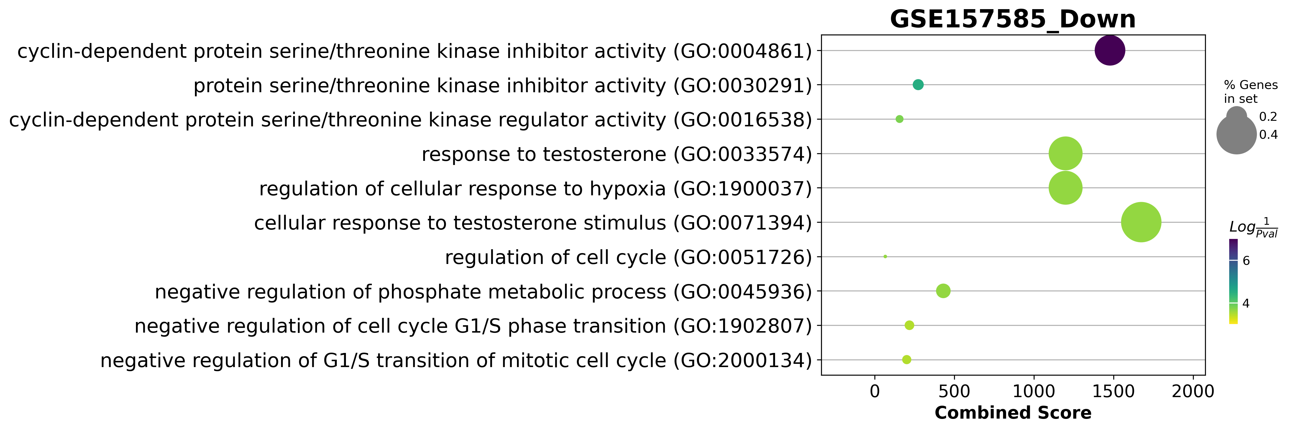
GSE157585 Dotplot

Slide 14
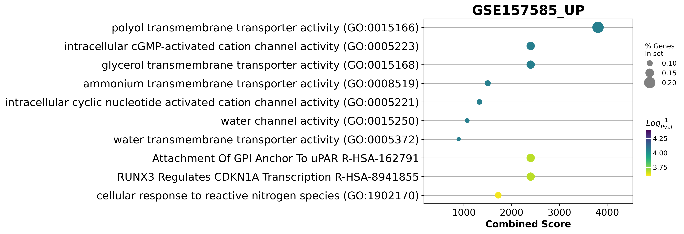
GSE157585 Dotplot

Slide 15
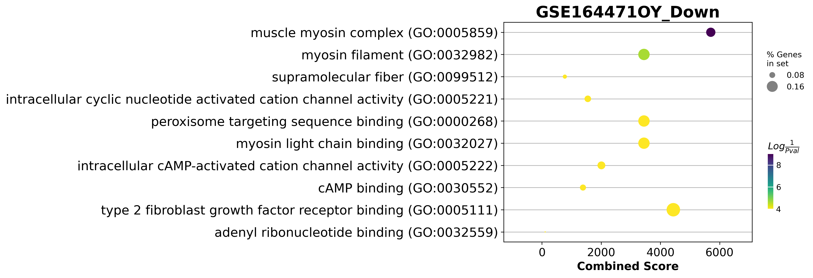
GSE164471 Dotplot

Slide 16
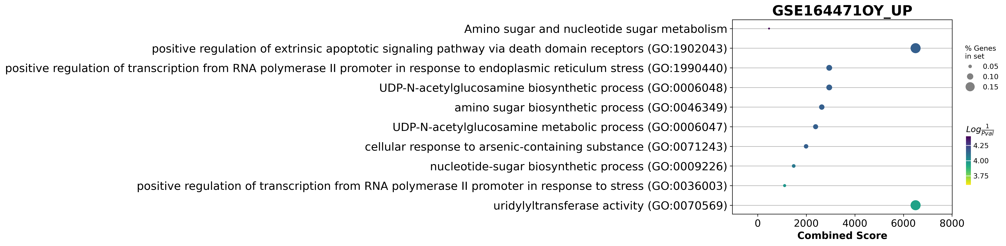

Slide 17
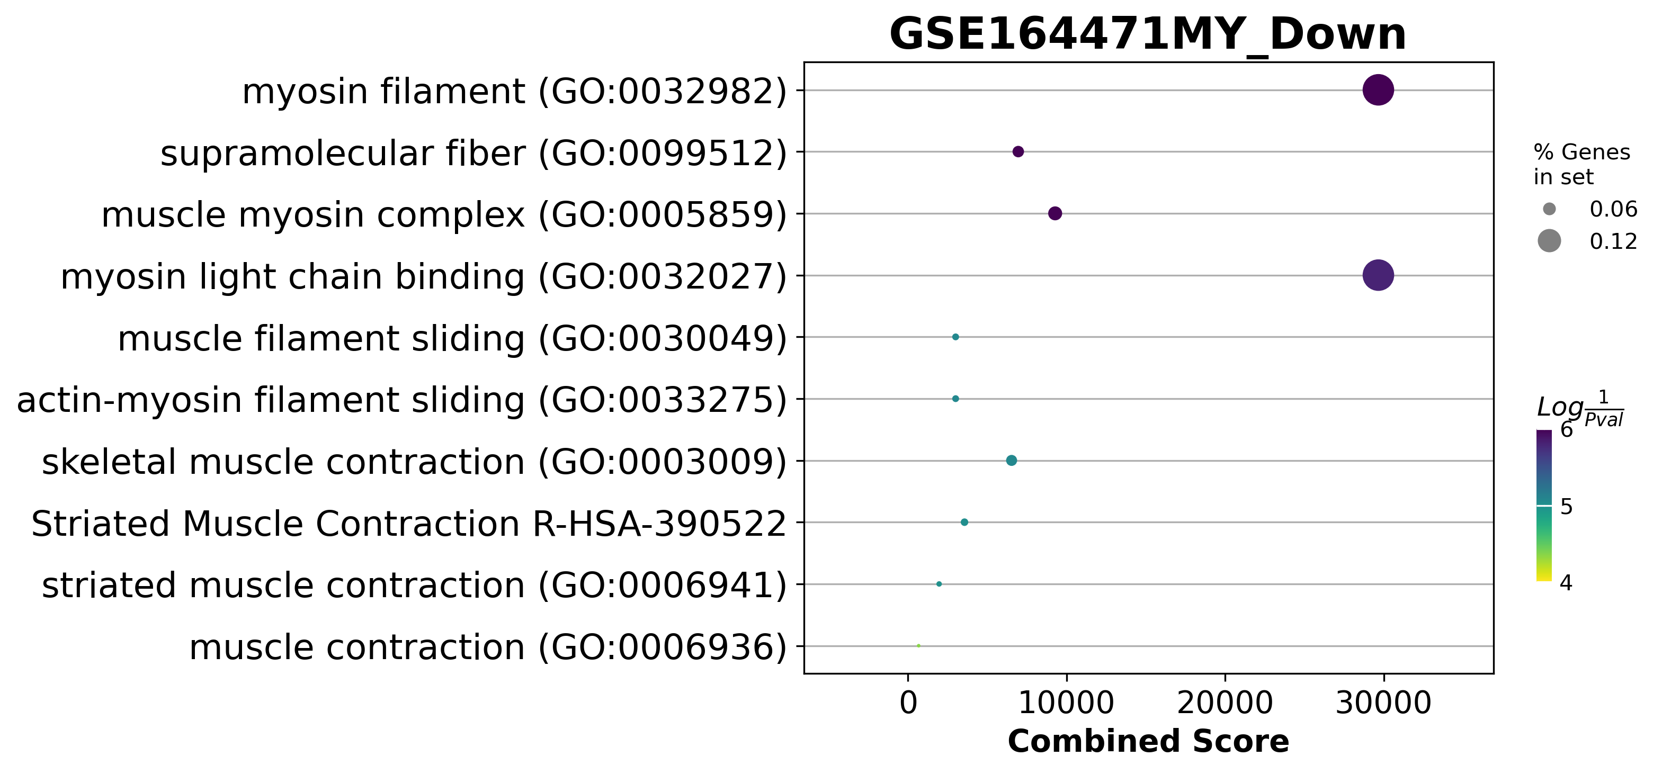
GSE164471(YM) Dotplot
UP regulated
DOWN regulated

Slide 19
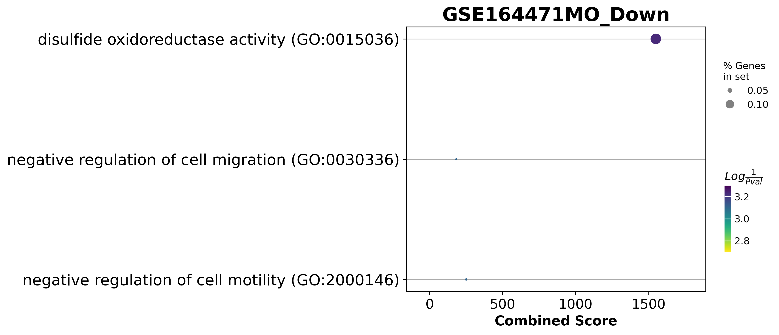
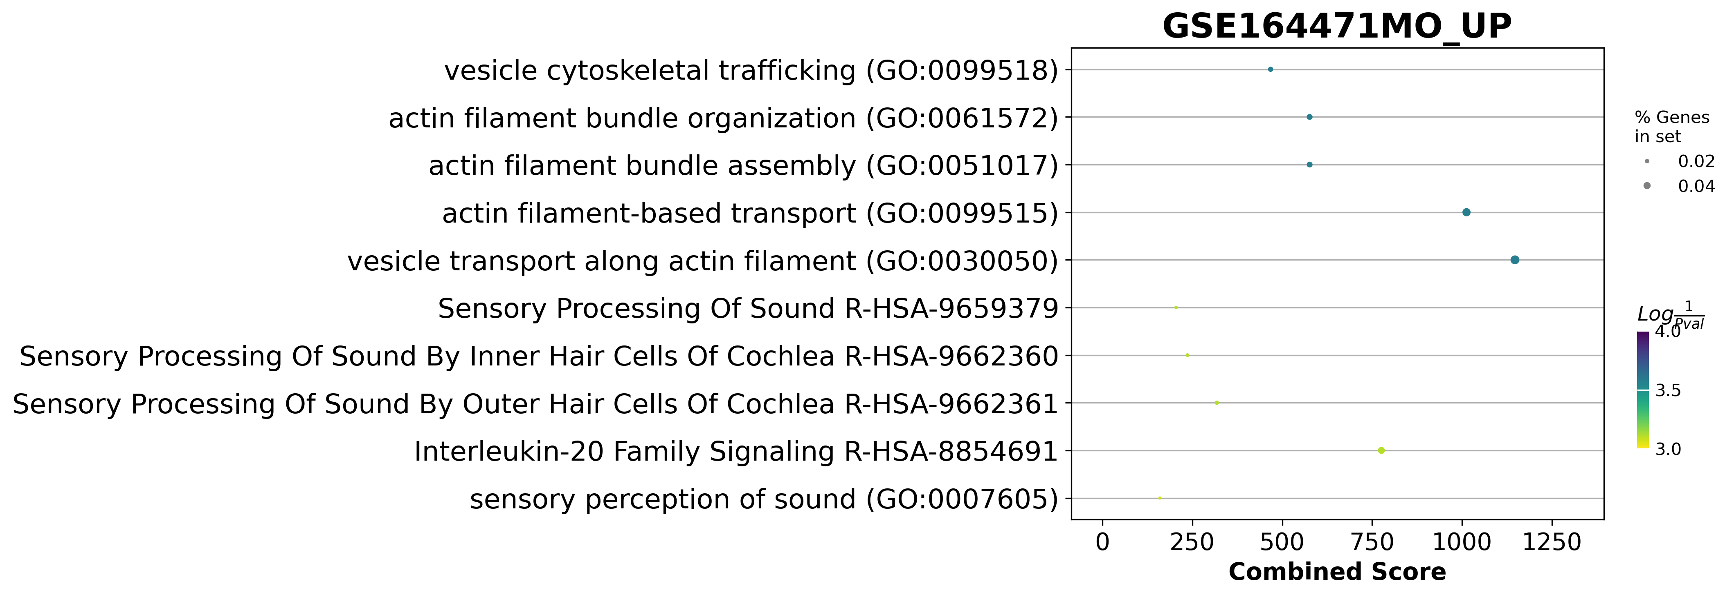
GSE164471(MO) Dotplot
UP regulated
DOWN regulated

Slide 20
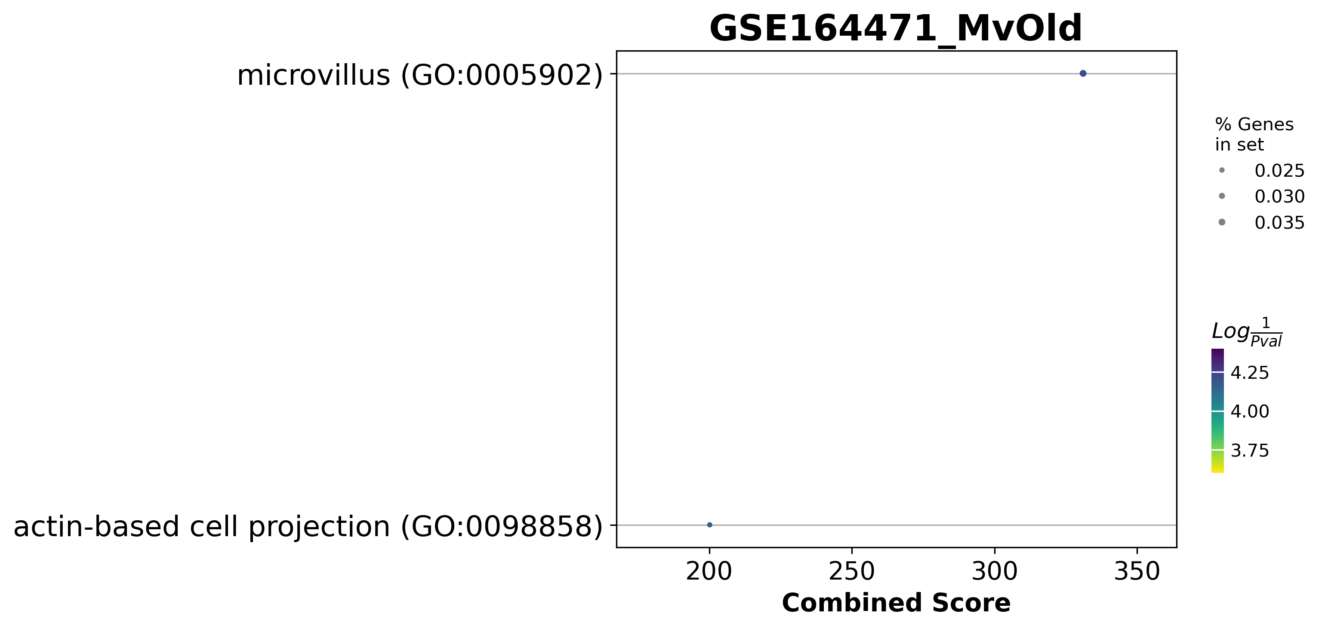

Slide 22
C
Notes:
We mentioned that aging have a lot of factors attached to it, in the specific case of Sarcopenia we can include chronic inflammation, increased reactive oxidative species, and increased fibrosis of muscle, among others have been reported to contribute to development of sarcopenia

Slide 23
C
Notes:
We mentioned that aging have a lot of factors attached to it, in the specific case of Sarcopenia we can include chronic inflammation, increased reactive oxidative species, and increased fibrosis of muscle, among others have been reported to contribute to development of sarcopenia

Slide 24
C
Notes:
We mentioned that aging have a lot of factors attached to it, in the specific case of Sarcopenia we can include chronic inflammation, increased reactive oxidative species, and increased fibrosis of muscle, among others have been reported to contribute to development of sarcopenia

Slide 25
Acknowledgements
This presentation has emanated from research conducted with the financial support of Science Foundation Ireland under Grant number [18/CRT/6214 ]

Slide 26


Slide 27
Read and get familiarize with:
TargetScan
miRNet
Enrichr
Cytoscape
PathVisio
Ingenuity Pathway Analysis
Complex Pathway Simulator
GENE Expression Omnibus
Xpress

Slide 28
Thank You

Slide 29
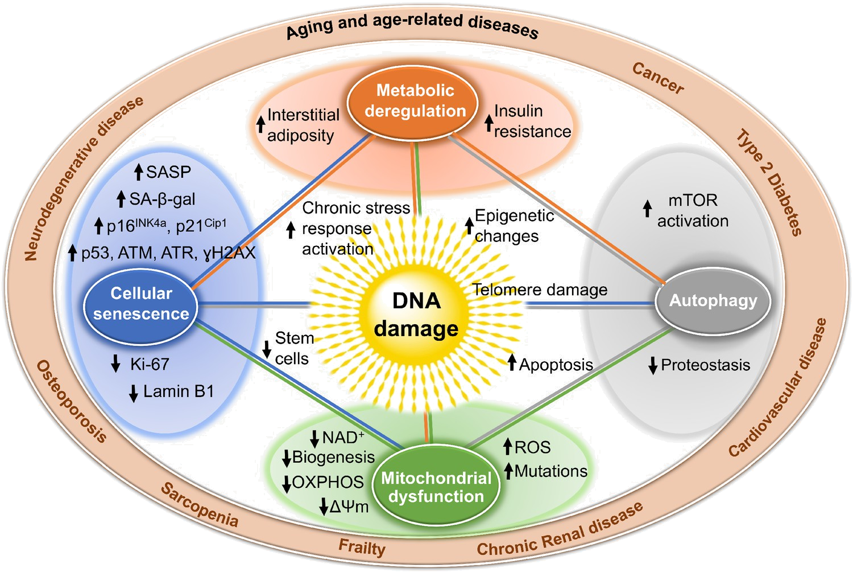
Why miRNAS
Notes:
Well, Aging is the cause of Sarcopenia, but this involves plenty of different processes that make it complicated to approach by isolating one pathway or one gene. And using small molecules work as a preventive method, they don’t regenerate the muscle. , microRNA allows a cleaner approach, because we can know the target and escalate to more parts of the body.

Slide 30
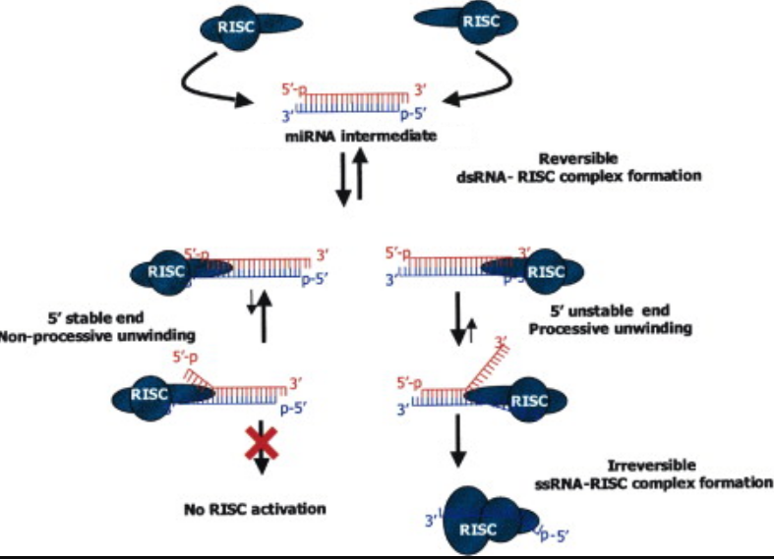
miRNA duplex
Notes:
Edited from https://www.cell.com/fulltext/S0092-8674(03)00801-8

